Slide 1
Risk Management for Commercial Real Estate Investing
June, 2017
Courtland Partners, Ltd. | Institutional Real Asset Advisor
Los Angeles | Cleveland | London

Slide 2
What is risk management?
For our purposes risk management will be defined by the following characteristics:
Identifying drawdown risk
Quantifying drawdown risk
Managing drawdown risk
To approach this for commercial real estate investors, we need to understand the factors that affect return for commercial real estate and how each of these factors can potentially impact a drawdown

Slide 3
Components of Real Estate Return
Shown below are the formulas that describe the relationship between total real estate return and the components of the return
We can then break cash flow down into its component parts of NOI and Capex
CF = NOI – Capex
We can then restate each of these components as a percentage of the initial investment basis which will allow a calculation of the return as a percent of the investment basis
k_{RE asset} = NOI Yield – Basis growth + NOI growth
Source: Pagliari

Slide 4
Components of Real Estate Return
To have this formula be relevant to an actual real estate investment, an asset management fee can be included which is stated as a fee as a percent of the equity invested
k_{unlevered RE fund} _{gross of cap rate change}= NOI Yield – Basis growth + NOI growth – Asset Management Fee
Next we need to adopt the model to incorporate the use of financial leverage
k_{levered RE fund} _{gross of cap rate change} = (1 + leverage) * (NOI Yield – Basis growth + NOI growth) – (leverage * economic leverage cost) – Asset Management Fee
Finally we need to include a component to account for the change in cap rate which may be positive or negative
k_{levered RE fund} _{net of cap rate change} = (1 + leverage) * (NOI Yield – Basis growth + NOI growth) – (leverage * economic leverage cost) + net effect of cap rate change – Asset Management Fee
Source of Formulas: Pagliari

Slide 5
Components of Real Estate Return
Components of Real Estate Return
NOI Yield
NOI Growth
Basis Growth
Leverage
Economic Leverage Cost
Asset Management Fee
Net Effect of Cap Rate Change
We will look at each component and determine the sensitively of a potential drawdown to changes in each component

Slide 6
NOI Yield
Looking at the return formula for real estate, we see that a change in NOI yield will have a linear effect on returns if there is no financial leverage
A 1% increase in NOI Yield will increase the fund return by 1%
The use of financial leverage will exacerbate the effect of a change in NOI yield in a linear fashion
A 1% increase in NOI Yield on a 50% leveraged fund will increase the fund return by 1.5%
k_{levered RE fund} _{net of cap rate change} = (1 + leverage) * (NOI Yield – Basis growth + NOI growth) – (leverage * economic leverage cost) + net effect of cap rate change – Asset Management Fee

Slide 7
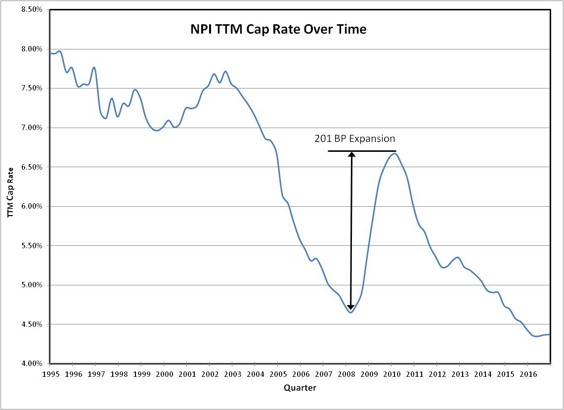
Historic NOI Yield
Shown below is the historic NOI yield over time
It has contracted by approximately 370 bp since the beginning of 1995

Slide 8
NOI Growth
Looking at the return formula for real estate, we see that a change in NOI growth will have a linear effect on returns if there is no financial leverage
A 1% increase in NOI Growth will increase the fund return by 1%
The use of financial leverage will exacerbate the effect of a change in NOI yield in a linear fashion
A 1% increase in NOI Growth on a 50% leveraged fund will increase the fund return by 1.5%
NOI Growth has historically had an annual volatility of 4.45% with lower growth rates coming during recessions
k_{levered RE fund} _{net of cap rate change} = (1 + leverage) * (NOI Yield – Basis growth + NOI growth) – (leverage * economic leverage cost) + net effect of cap rate change – Asset Management Fee

Slide 9
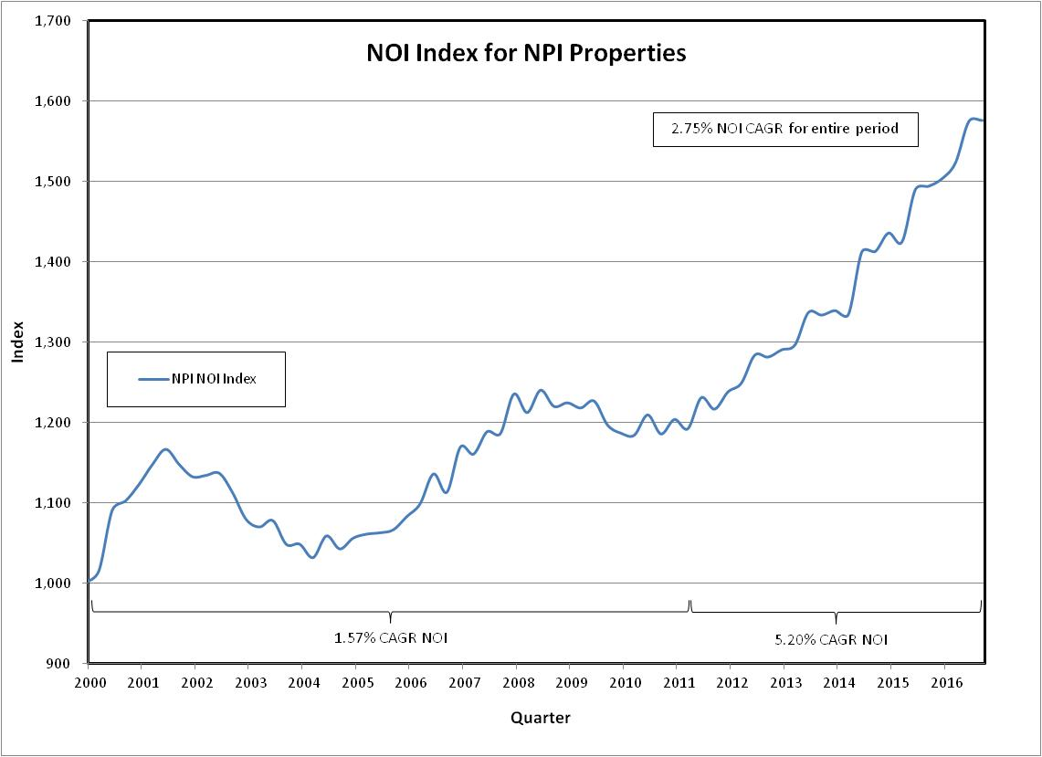
NOI Growth
Shown below is the historic NOI growth for NPI properties
Since 2000 the CAGR has been 2.75% with higher growth of 5.2% for the period starting in 2Q11 and going to 3Q16

Slide 10
Basis Growth
Looking at the return formula for real estate, we see that a change in Basis growth will have a linear effect on returns if there is no financial leverage
A 1% increase in Basis Growth will decrease the fund return by 1%
The use of financial leverage will exacerbate the effect of a change in Basis growth in a linear fashion
A 1% increase in Basis Growth on a 50% leveraged fund will decrease the fund return by 1.5%
Basis Growth has historically had an annual volatility of 0.32% as it is little affected by economic conditions
k_{levered RE fund} _{net of cap rate change} = (1 + leverage) * (NOI Yield – Basis growth + NOI growth) – (leverage * economic leverage cost) + net effect of cap rate change – Asset Management Fee

Slide 11
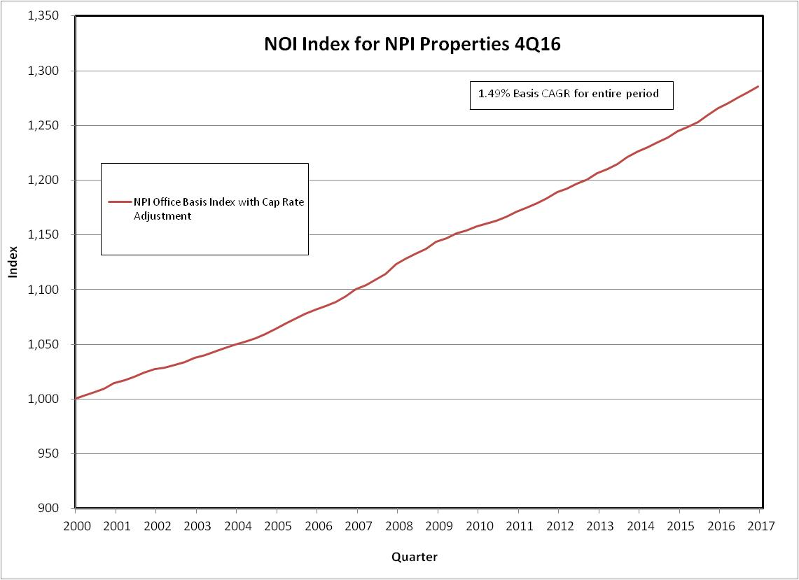
Basis Growth
Shown below is the historic Basis growth for NPI properties
Since 2000 the CAGR has been 1.49% with little change during recessions

Slide 12
Leverage
Looking at the return formula for real estate, we see that a change in leverage will exacerbate the spread between the asset return and the economic leverage cost
Basis growth will have a linear effect on returns if there is no financial leverage
A 1% increase in Basis Growth will decrease the fund return by 1%
The use of financial leverage will exacerbate the effect of a change in Basis growth in a linear fashion
A 1% increase in Basis Growth on a 50% leveraged fund will decrease the fund return by 1.5%
Basis Growth has historically had an annual volatility of 0.32% as it is little affected by economic conditions
k_{levered RE fund} _{net of cap rate change} = (1 + leverage) * (NOI Yield – Basis growth + NOI growth) – (leverage * economic leverage cost) + net effect of cap rate change – Asset Management Fee

Slide 13
Leverage Risk Effect
Shown below is a diagram illustrating the effect of leverage over time with a fixed cost of debt and a random asset return with a higher expected return than the cost of debt
Leverage will serve to exacerbate the spread between the return on assets to the cost of debt while increasing the volatility of equity in accordance to the formula presented below
Asset Volatility 4%
Debt Volatility 0%
Resulting Equity Volatility 8%
Source of Chart and Formula: Pagliari : Notes for class #6 and #7 Winter Quarter 2017

Slide 14
Economic Leverage Cost
As described in the slide on the effect of leverage, the cost of debt will affect equity returns to the extent that the spread between asset return and debt cost changes
To select a data series that represents the cost of debt, the series can be tested against a known series of the actual cost of debt
k_{levered RE fund} _{net of cap rate change} = (1 + leverage) * (NOI Yield – Basis growth + NOI growth) – (leverage * economic leverage cost) + net effect of cap rate change – Asset Management Fee
Source of Chart and Formula: Pagliari : Notes for class #6 and #7 Winter Quarter 2017

Slide 15
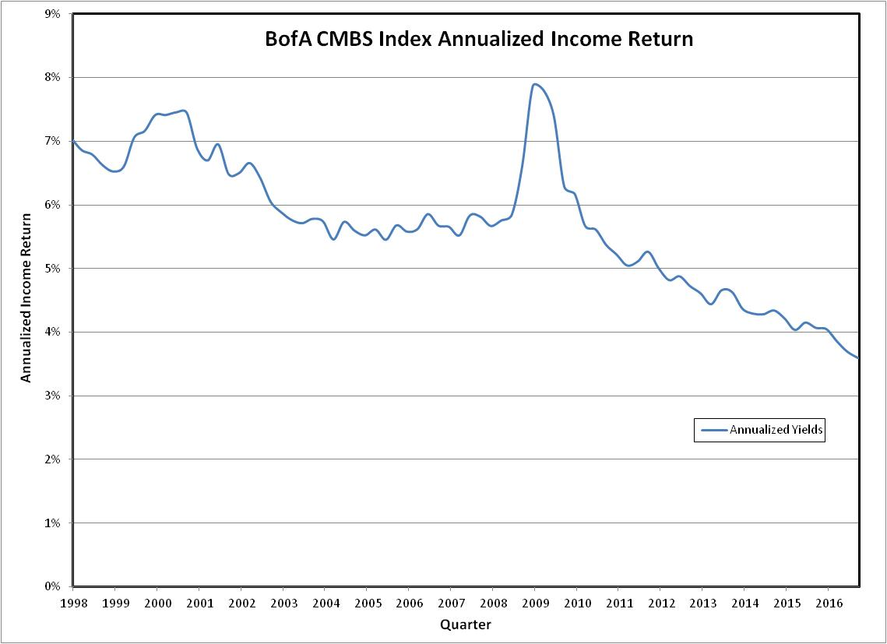
Debt Cost
Shown below is the annualized income return for the BofA CMBS Index

Slide 16
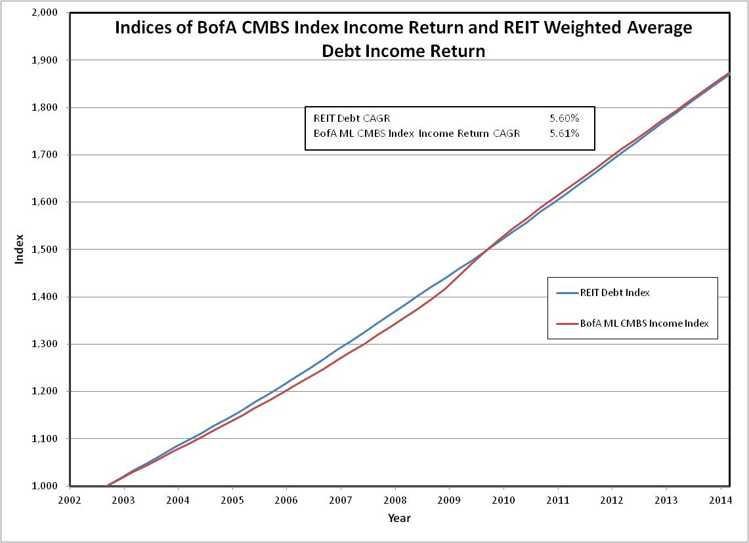
Debt Cost
Shown below are indices for publicly traded REIT average weighted average cost of debt and the income return for the BofA CMBS Index
As depicted, the BofA CMBS Index income returns very closely resemble the debt cost for publicly traded REITs
It is assumed that the debt cost for private real estate funds is similar to that of publicly traded REITs and therefore the BofA CMBS Index income return

Slide 17
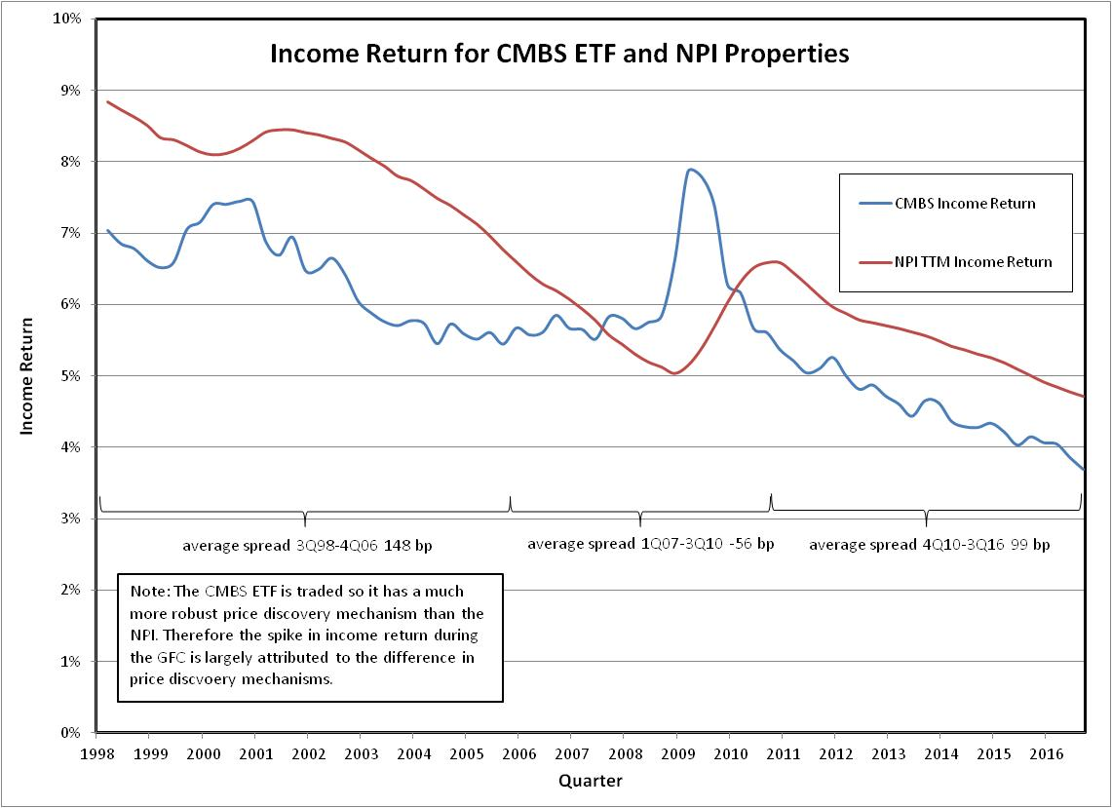
Relationship Between NPI Income Return and Cost of Debt
Shown below are annualized income returns for NPI properties and the income returns of the BofA CMBS Index
The price discovery mechanism for the BofA CMBS Index is much more robust than that of the NPI, especially during the GFC where very few NPI properties were trading which is largely the cause for the spike in the CMBS income return during the GFC
Outside of the GFC, the spread between the CMBS income return and NPI income return is generally between 1% and 2%

Slide 18
Asset Management Fee
Shown below is a table showing the average spread between gross and net returns for the ODCE index
This spread is 97 bp of equity and the variance from year to year is non-material so it is considered fixed at 97 bp

Slide 19
Net Effect of Cap Rate Change
Per the return formula below, the net effect of cap rate change is a separate factor that contributes to returns
It will be shown that this factor is the main contributor to drawdown risk as changes in cap rate can potentially have dramatic changes on future returns
k_{levered RE fund} _{net of cap rate change} = (1 + leverage) * (NOI Yield – Basis growth + NOI growth) – (leverage * economic leverage cost) + net effect of cap rate change – Asset Management Fee

Slide 20
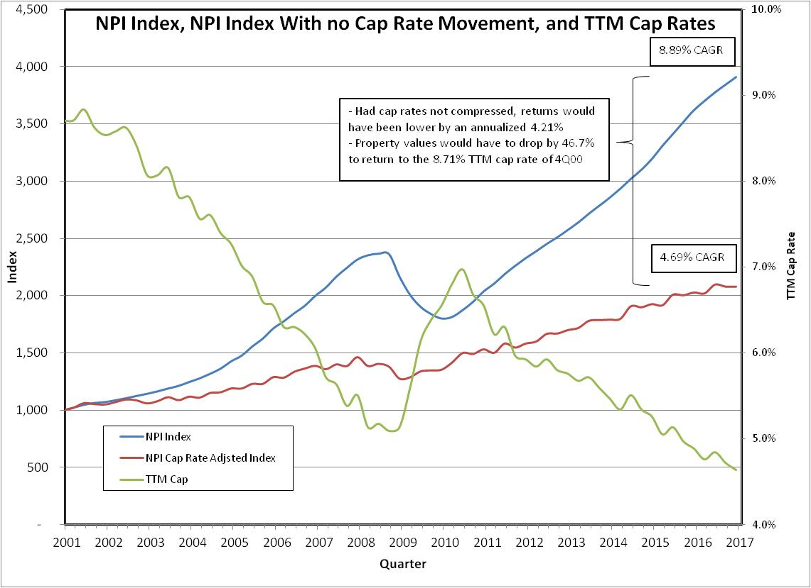
Historic Net Effect of Cap Rate Change
Cap Rate change has contributed an average of 4.21% to returns annually since 2001

Slide 21
Risk Management Model
The following are the components of real estate return and the inputs used in the model
NOI Yield
NPI annualized income return of 4.64% as of 4Q16
NOI Growth
Historic growth rate since 2000 of 2.75%
Basis Growth
Historical growth rate since 2000 of 1.49%
Leverage
Model shows sensitivity of 0%, 25%, and 50%
Economic Leverage Cost
Annualized BofA CMBS income return in 4Q16 of 3.60%
Asset Management Fee
Average spread between gross and net ODCE returns in the past 10 years of 97 bp
Net Effect of Cap Rate Change
Model shows sensitivity to 0, 50, and 100 bp increases in cap rates
The model shows the effect of the cap rate movements on annualized returns over 1-10 year periods

Slide 22
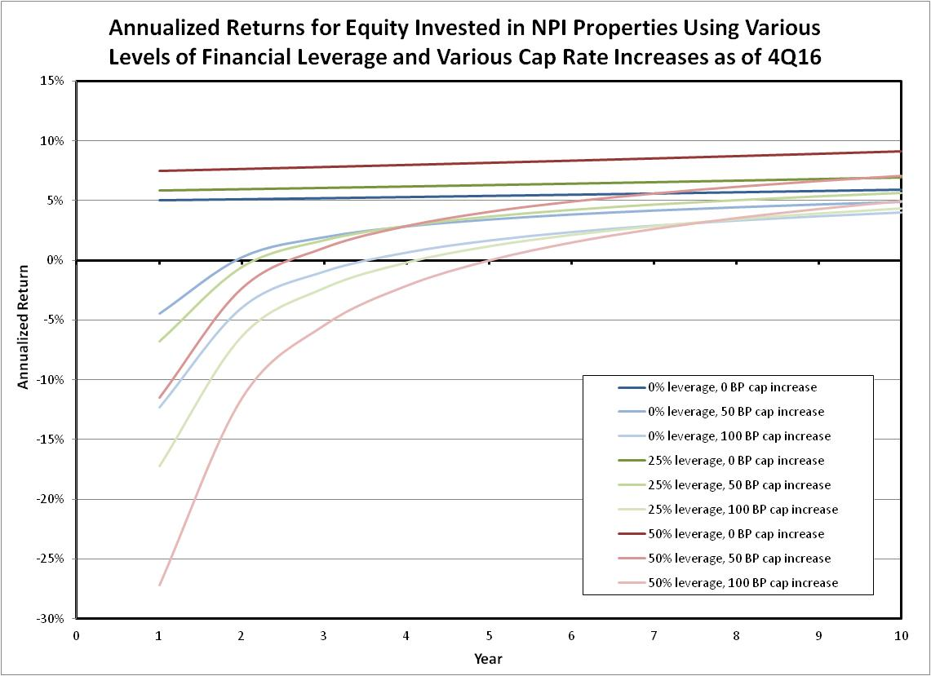
Risk Management Model

Slide 23
Risk Management Model Observations
The expected returns net of fees in year one if there is no change in cap rate movement are as follows:
5.06% for 0% leverage
5.86% for 25% leverage
7.48% for 50% leverage
The drawdown risk is significantly affected by the use of leverage
It would take 5 years for a 50% levered investment to make enough in income returns to offset a 100 bp increase in cap rate and bring the annualized return to approximately 0%
This analysis only includes the effects of a 100 bp increase in cap rate whereas cap rates have decreased by over 400 bp since 1995
Non-core assets such as value add and opportunistic assets have price volatility greater than those tracked in the NPI so their draw downs would likely be greater than presented here
Changes to inputs to the model other than leverage and cap rate movements will largely cause a linear parallel movement in each return curve

Slide 24
Binomial Cap Rate Movement Model
Using the valuation model described earlier and using the same projected NOI growth, basis growth, leverage cost, and management fee assumption, we can calculate the probability density function of future returns
To do this we can treat cap rate movements as a stochastic process and project future cap rate movements using projected volatility similar to historical volatility
On the next page is shown the binomial tree depicting the future potential cap rate paths
The following page shows the total capital return associated with each node in the binomial tree
Finally the probability density function of the total 5 year returns is shown

Slide 25
Cap Rate Binomial Tree
Cap Rate Tree
0 |  | 1 |  | 2 |  | 3 |  | 4 |  | 5
year
 |  |  |  |  |  |  |  |  |  | 7.96%
 |  |  |  |  |  |  |  |  | 7.55%
 |  |  |  |  |  |  |  | 7.15% |  | 7.15%
 |  |  |  |  |  |  | 6.77% |  | 6.77%
 |  |  |  |  |  | 6.42% |  | 6.42% |  | 6.42%
 |  |  |  |  | 6.08% |  | 6.08% |  | 6.08%
 |  |  |  | 5.76% |  | 5.76% |  | 5.76% |  | 5.76%
 |  |  | 5.46% |  | 5.46% |  | 5.46% |  | 5.46%
 |  | 5.17% |  | 5.17% |  | 5.17% |  | 5.17% |  | 5.17%
 | 4.90% |  | 4.90% |  | 4.90% |  | 4.90% |  | 4.90%
4.64% |  | 4.64% |  | 4.64% |  | 4.64% |  | 4.64% |  | 4.64%
 | 4.39% |  | 4.39% |  | 4.39% |  | 4.39% |  | 4.39%
 |  | 4.16% |  | 4.16% |  | 4.16% |  | 4.16% |  | 4.16%
 |  |  | 3.94% |  | 3.94% |  | 3.94% |  | 3.94%
 |  |  |  | 3.74% |  | 3.74% |  | 3.74% |  | 3.74%
 |  |  |  |  | 3.54% |  | 3.54% |  | 3.54%
 |  |  |  |  |  | 3.35% |  | 3.35% |  | 3.35%
 |  |  |  |  |  |  | 3.18% |  | 3.18%
 |  |  |  |  |  |  |  | 3.01% |  | 3.01%
 |  |  |  |  |  |  |  |  | 2.85%
 |  |  |  |  |  |  |  |  |  | 2.70%

Slide 26
Capital Return Binomial Tree
Capital Return Due to Cap Rate Change
0 |  | 1 |  | 2 |  | 3 |  | 4 |  | 5
year
 |  |  |  |  |  |  |  |  |  | -41.8%
 |  |  |  |  |  |  |  |  | -38.5%
 |  |  |  |  |  |  |  | -35.1% |  | -35.1%
 |  |  |  |  |  |  | -31.5% |  | -31.5%
 |  |  |  |  |  | -27.7% |  | -27.7% |  | -27.7%
 |  |  |  |  | -23.7% |  | -23.7% |  | -23.7%
 |  |  |  | -19.4% |  | -19.4% |  | -19.4% |  | -19.4%
 |  |  | -15.0% |  | -15.0% |  | -15.0% |  | -15.0%
 |  | -10.2% |  | -10.2% |  | -10.2% |  | -10.2% |  | -10.2%
 | -5.26% |  | -5.3% |  | -5.3% |  | -5.3% |  | -5.3%
0.0% |  | 0.0% |  | 0.0% |  | 0.0% |  | 0.0% |  | 0.0%
 | 5.6% |  | 5.6% |  | 5.6% |  | 5.6% |  | 5.6%
 |  | 11.4% |  | 11.4% |  | 11.4% |  | 11.4% |  | 11.4%
 |  |  | 17.6% |  | 17.6% |  | 17.6% |  | 17.6%
 |  |  |  | 24.1% |  | 24.1% |  | 24.1% |  | 24.1%
 |  |  |  |  | 31.0% |  | 31.0% |  | 31.0%
 |  |  |  |  |  | 38.3% |  | 38.3% |  | 38.3%
 |  |  |  |  |  |  | 46.0% |  | 46.0%
 |  |  |  |  |  |  |  | 54.1% |  | 54.1%
 |  |  |  |  |  |  |  |  | 62.7%
 |  |  |  |  |  |  |  |  |  | 71.7%

Slide 27
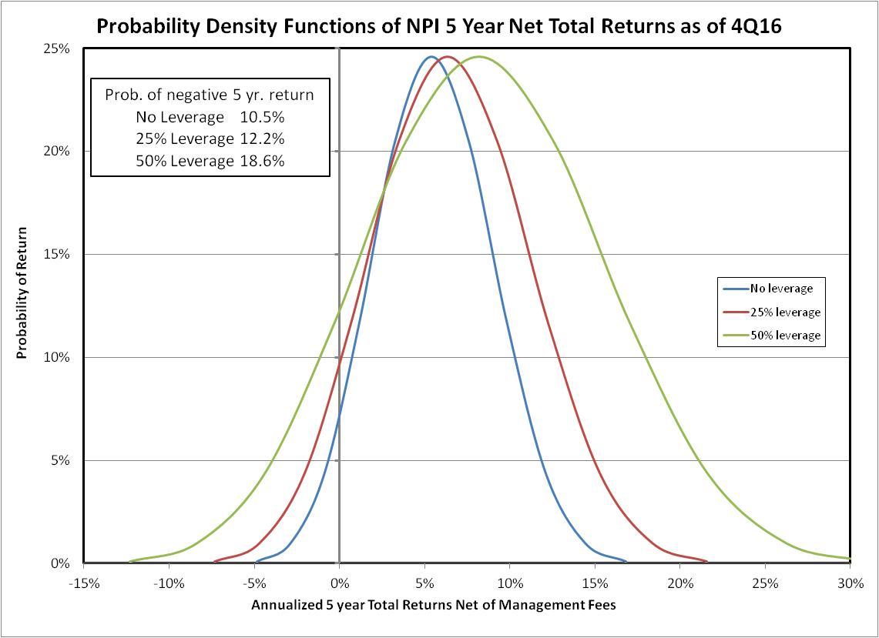
Probability Density Function of 5 Yr. Returns

Slide 28
Risk Management Conclusions
The probability density function graphically shows that the additional use of financial leverage adds significant variance to the potential future returns
The probability of a negative 5 year total return is as follows:
No leverage 10.5%
25% leverage 12.2%
50% leverage 18.6%
The use of financial leverage exacerbates the positive capital return associated with cap rate compression and the negative capital return associated with cap rate expansion
Investors should understand the risk versus reward tradeoff associated with the use of financial leverage and be comfortable that their portfolio matches their risk tolerance

Slide 29
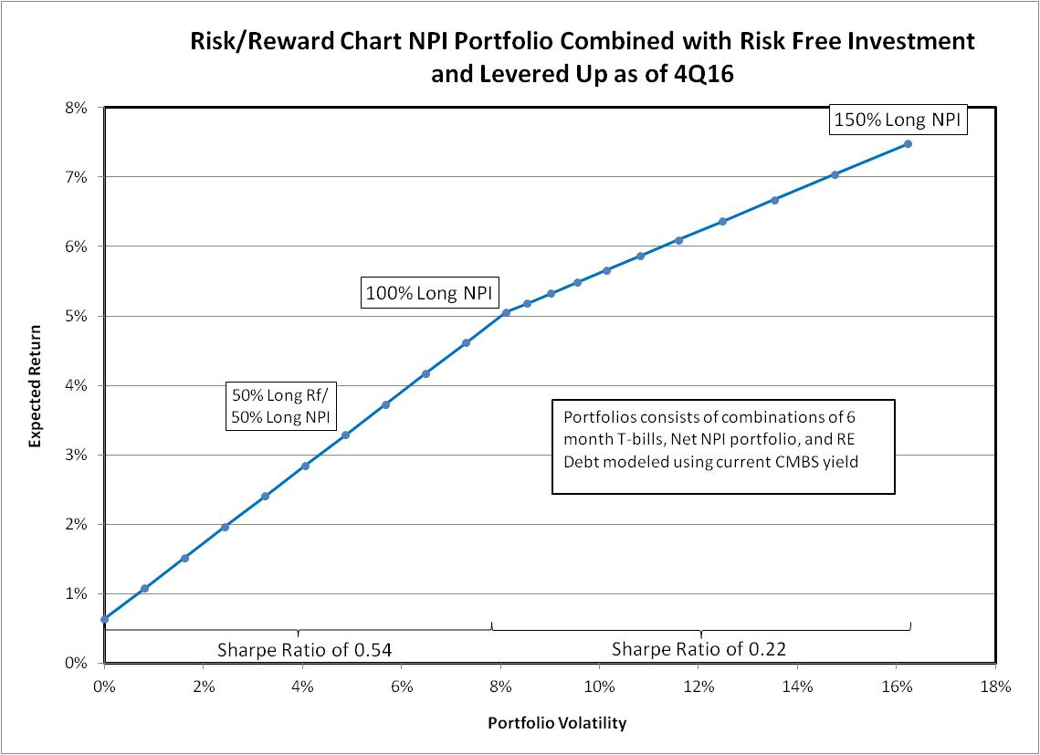
Sharpe Ratio

Slide 30
Sharpe Ratio
The Sharpe Ratio for portfolio combinations of the risk free investment and the NPI Net investment is .54
The Sharpe Ratio for portfolio combinations that include going long the NPI and short the mortgage market is .22
The risk versus reward tradeoff associated with adding financial leverage is approximately 40% in comparison to owing an asset with no leverage
This means that when levering NPI properties, investors are getting approximately one third of the return for each additional unit of risk in comparison to the unlevered investment in the NPI

